Slide 1
CS217 – Object Oriented Programming (OOP)
Week – 08, 09 and 10
Mar 21- April 08, 2022
Instructor: Basit Ali

Slide 2
Recap – Inheritance
Derived class inherits all the characteristics of the base class
Besides inherited characteristics, derived class may have its own unique characteristics
Major benefit of inheritance is reuse

Slide 3
Generalization
In OO models, some classes may have common characteristics
We extract these features into a new class and inherit original classes from this new class
This concept is known as Generalization

Slide 4
Example – Generalization
Line
Circle
Triangle
color
vertices
length
color
vertices
radius
color
vertices
angle
move
setColor
getLength
move
setColor
computeArea
move
setColor
computeArea

Slide 5
Shape
color
vertices
move
setColor
Triangle
Circle
radius
Line
angle
computeArea
length
computeArea
getLength

Slide 6
Polymorphism
The process of representing one Form in multiple forms is known as Polymorphism
Polymorphism is derived from 2 Greek words: poly and morphs. The word "poly" means many and morphs means forms. So polymorphism means many forms.

Slide 7
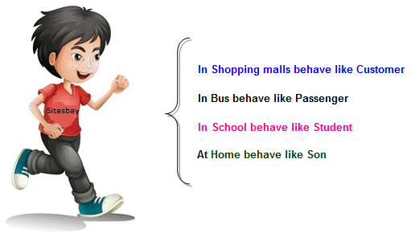
Real life example of Polymorphism
Suppose if you are in class room that time you behave like a student, when you are in market at that time you behave like a customer, when you at your home at that time you behave like a son or daughter, Here one person have different-different behaviors.

Slide 8
Type of Polymorphism
Static / Compile time polymorphism
Dynamic / Run time polymorphism

Slide 9
Static / Compile time polymorphism
It is also called Early Binding
It happens where more than one methods share the same name with different parameters or signature and different return type.
It is known as Early Binding because the compiler is aware of the functions with same name and also which overloaded function is to be called is known at compile time.

Slide 10
Function/Method Overloading
Whenever same method name is exiting multiple times in the same class with different number of parameter or different order of parameters or different types of parameters is known as method overloading

Slide 11
Static / Compile time polymorphism
Overloading
Function Overloading (ALREADY DISCUSSED)
Constructor Overloading (ALREADY DISCUSSED)
Operator Overloading (TO BE DISCUSSED)

Slide 12
Dynamic / Run time polymorphism
This refers to the entity which changes its form depending on circumstances at runtime. This concept can be adopted as analogous to a chameleon changing its color at the sight of an approaching object.
Method Overriding uses runtime Polymorphism.
It is also called Late Binding.

Slide 13
Dynamic / Run time polymorphism
Runtime Polymorphism is done using virtual and inheritance.
When overriding a method, the behavior of the method is changed for the derived class.

Slide 14
Overriding
A class may need to override the default behavior provided by its base class
Reasons for overriding
Provide behavior specific to a derived class
Extend the default behavior
Restrict the default behavior
Improve performance

Slide 15
Function/Method Overriding
Define any method in both base class and derived class with same name, same parameters or signature, this concept is known as method overriding

Slide 16
Example – Specific Behavior
color
vertices
draw
move
setColor
Triangle
Circle
radius
Line
angle
draw
computeArea
length
draw
computeArea
draw

Slide 17
Example – Improve Performance
Shape
color
coord
Class Circle overrides rotate operation of class Shape with a Null operation.
draw
rotate
setColor
Circle
radius
draw
rotate

Slide 18
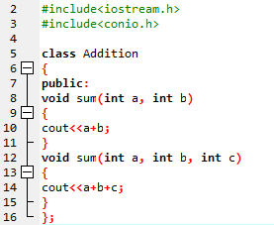
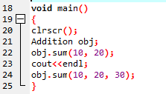
Example
Output:
30
60

Slide 19
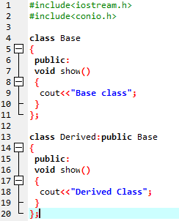
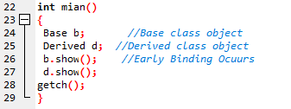
Example
Output:
Base class
Derived class

Slide 20
Hybrid Inheritance: Potential problem
common dangerous pattern: "The Diamond"
Classes B and C extend A
Class D extends A and B
Class D extends A and C
A
B
C
D

Slide 21
Problems with Hybrid Inheritance
Increased complexity
Reduced understanding
Duplicate features

Slide 22
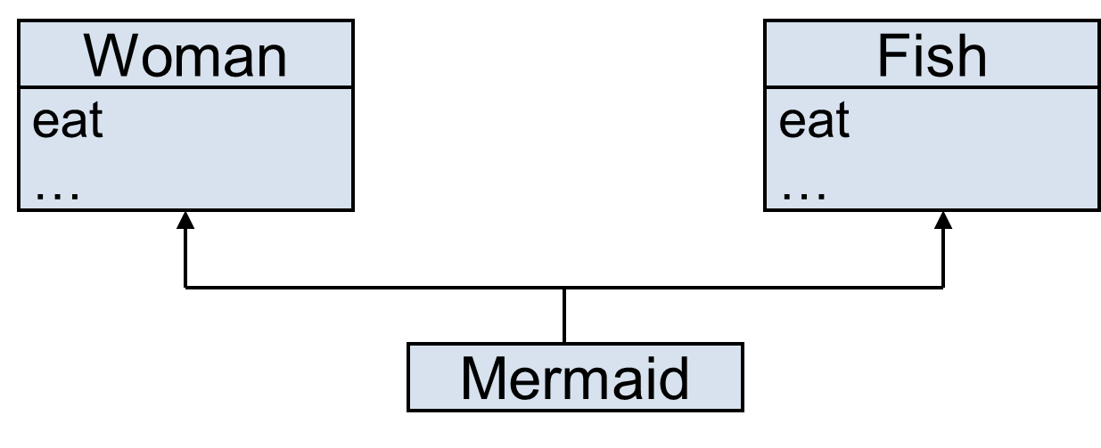
Problem – Duplicate Features
Which eat operation Mermaid inherits?

Slide 23
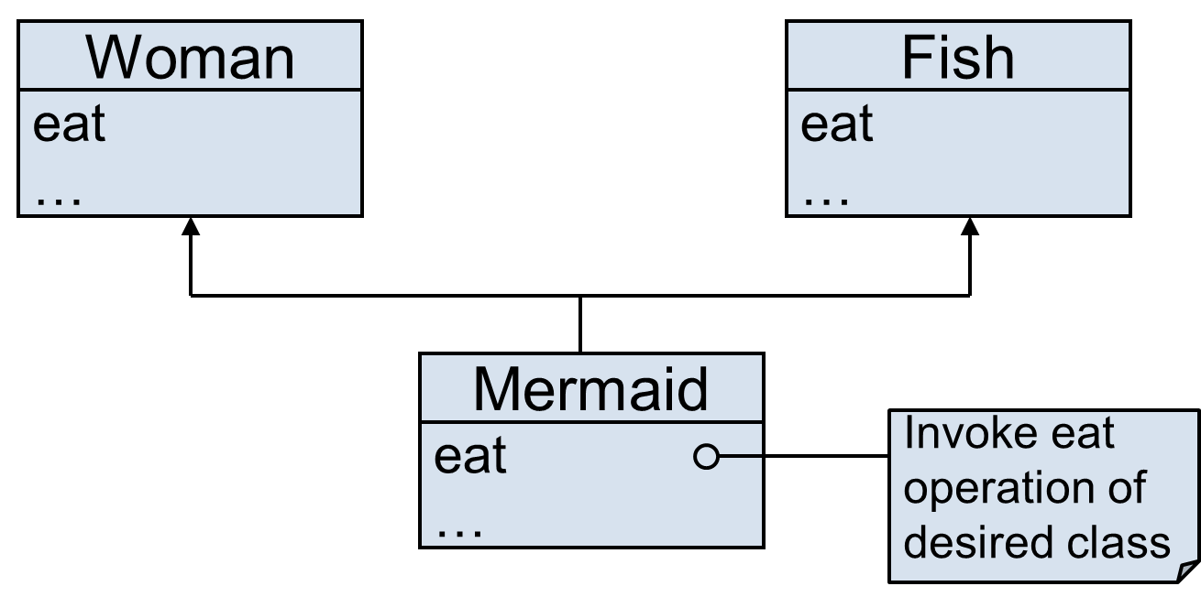
Solution – Override the Common Feature

Slide 24
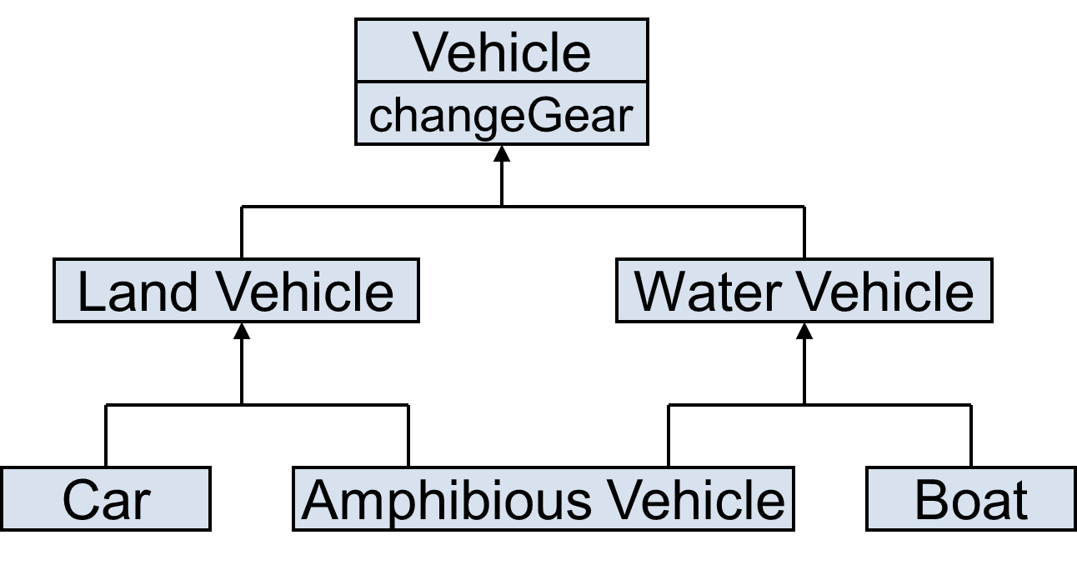
Problem – Duplicate Features (Diamond Problem)
Which changeGear operation Amphibious Vehicle inherits?

Slide 25
Solution to Diamond Problem
Some languages disallow diamond hierarchy
Others provide mechanism to ignore characteristics from one side

Slide 26


Solution to Diamond Problem (Virtual Inheritance)
What happens without virtual inheritance:
You want: (Achievable with virtual inheritance)

Slide 27
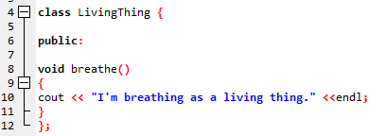
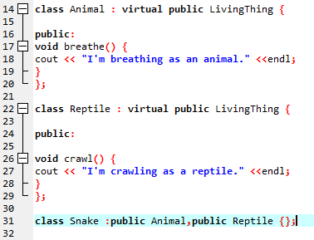
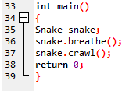
Solution..

Slide 28

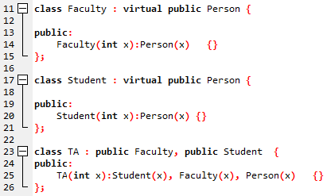

Diamond Problem Solution (With constructor)

Slide 29
Friend Function
A friend function of a class is defined outside that class' scope but it has the right to access all private and protected members of the class.
Even though the prototypes for friend functions appear in the class definition, friends are not member functions.

Slide 30
Friend Function
To declare a function as a friend of a class, precede the function prototype in the class definition with keyword friend as follows

Slide 31
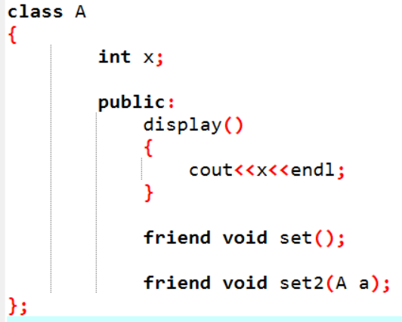
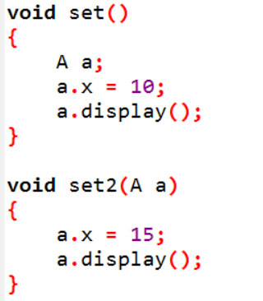
Implementation

Slide 32
Operator Overloading
In C++, we can make operators to work for user defined classes.
This means C++ has the ability to provide the operators with a special meaning for a data type, this ability is known as operator overloading.

Slide 33
Operator Overloading (Continue..)
For example, we can overload an operator ‘+’ in a class like String so that we can concatenate two strings by just using +
Other example classes where arithmetic operators may be overloaded are Complex Number, Fractional Number, Big Integer, etc.

Slide 34
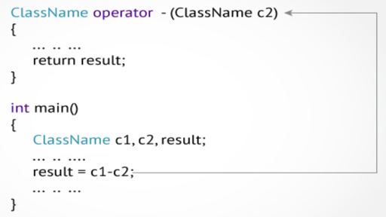
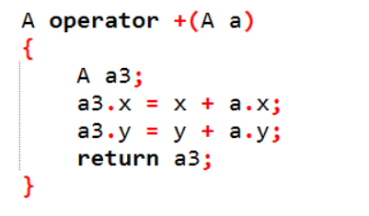
Operator Overloading (Continue..)
Overloaded operators are functions with special names: the keyword "operator" followed by the symbol for the operator being defined

Slide 35
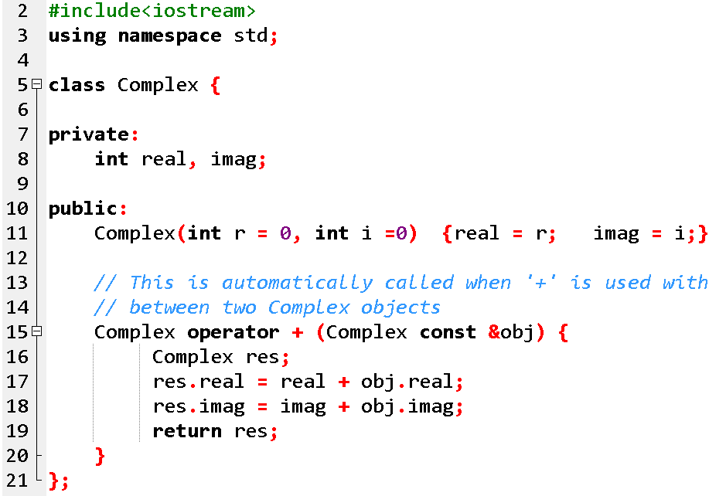
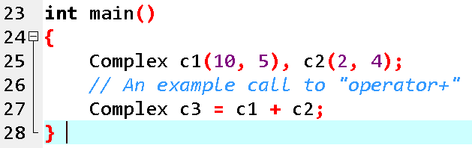
Operator Overloading (Continue..)

Slide 36
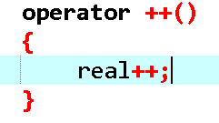
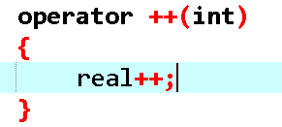
Operator Overloading (Continue..)
++object;
object++;

Slide 37
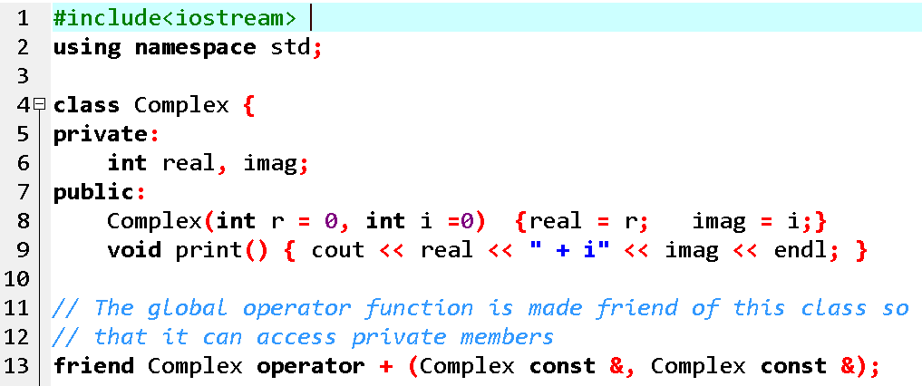
Global Operator Function

Slide 38
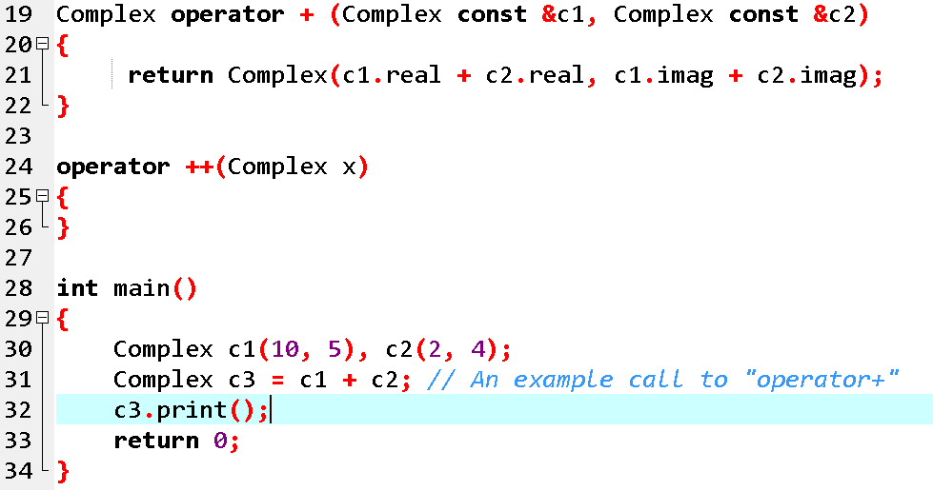
Global Operator Function

Slide 39
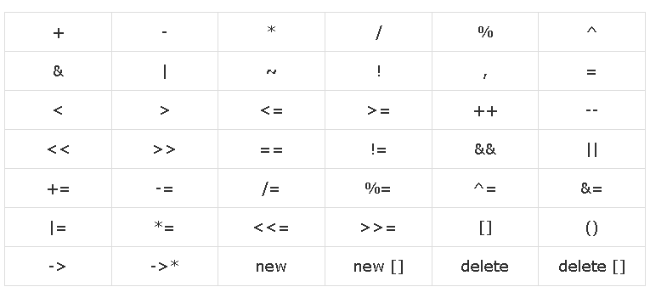
Overload-able Operators

Slide 40
Non-overload-able Operators

Slide 41
Overload << >> operators
friend ostream& operator<<( ostream &output, const Distance &D ) {
output << "F : " << D.feet << " I : " << D.inches;
return output; }
friend istream& operator>>( istream &input, Distance &D ) {
input >> D.feet >> D.inches;
return input; }

